Slide 1
Basics of Probability and Measures
Dolors Sala
First Quarter
2017-18

Slide 2
What is not defined can not be measured.
What is not measured can not be improved.
What has not improved is degraded forever.
William Thomson (Lord Kelvin), 1824-1907
Physicist and Mathematic

Slide 3
Why?
To study a system we need to identify the parameters to study
  Different observations of the same parameter produce different values because of the many system components involved
    Which value is the correct one?
      The average of all the values obtained?
      Can we summarize the set of observations with a single value? Which one? What does it represent?
      Do we have to reconstruct/infer the distribution function? How can be obtained it? What can we expect?

Slide 4
Bibliography
“The Art of Computer Systems”, R. Jain, Ed. John Wiley Sons Inc, 1991 (Chapter 12)
“Simulation Modeling and Analysis”, A. Law, (Chapter 4)
Some of these slides are based on the instructor’s slides (version 2010) supplied by Prof. Raj Jain, the Author of the book “The Art of Computer Systems Performance Analysis”

Slide 5
Outline
Basic Definitions (Probability and Statistics):
  CDF, PDF, PMF,
  Mean,Variance, CoV
Summarizing measured data by a single number
  Centrality measures
  Dispersion measures
Representing the full distribution of a data set
  Histogram
  Normal Distribution & Central limit theorem

Slide 6
Basic Definitions

Slide 7
Basic Probability and Statistics Concepts
Independent Events: Two events are called independent if the occurrence of one event does not in any way affect the probability of the other event
Random Variable: A variable is called a random variable if it takes one of a specified set of values with a specified probability
  Example: tossing a coin
    Set of values {Head, Tail}
    Fair coin probabilities {½, ½}

Slide 8
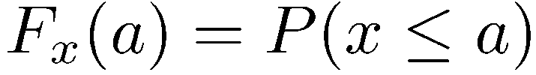
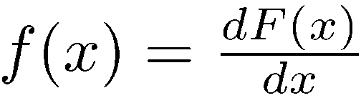
Functions to Characterize Random Variables
Cumulative Distribution Function (CDF):
Probability Density Function (PDF): For continuous random variables
1
F(x)
f(x)
0
x
x

Slide 9
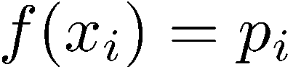
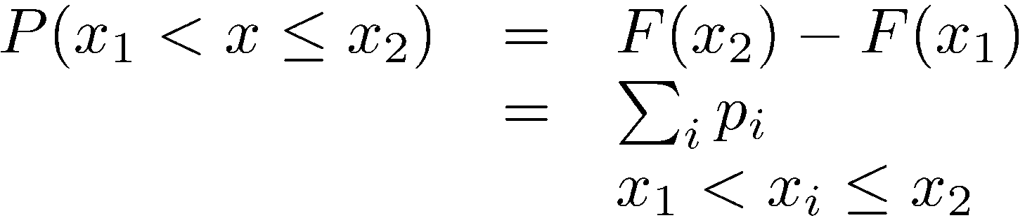
Functions to Characterize RVs (cont.)
Given a pdf f(x):
Probability Mass Function (PMF): For discrete random variables:
f(x_{i)}
x_{i}

Slide 10
Summarizing Data by a Single Number:
Indices of central tendencies of a (random) variable
  They represent a data set based on the communalities of the values
  Mean, Median, Mode
Indices of dispersion tendencies of a (random) variable
  They summarized a data set based on differences of the values
  Range, Variance, Standard deviation, Coefficient of variation
Indices of dependence of two (random) variables
  They summarized a data set based on the relation of the values
  Covariance, Correlation

Slide 11
Measures of Central Tendencies
Mean or Expected Value: (a measure of centrality)
Median: The 50-percentile or (0.5-quantile) of a random variable is called its median
Mode: The most likely value, that is, x_{i} that has the highest probability p_{i}, or the x at which pdf is maximum, is called mode of x
Mode
1.00
0.75
f(x)
F(x)
0.50
0.25
Median
0.00
x_{median}
x_{mode}

Slide 12
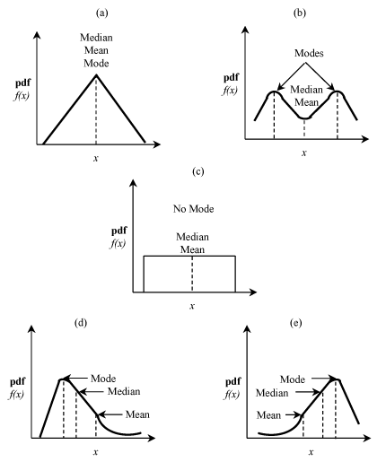
Examples
Only measures of centrality not enough to characterize/distinguish the functions
Notes:
Mean and median always exist and are unique. Mode, on the other hand, may not exist

Slide 13
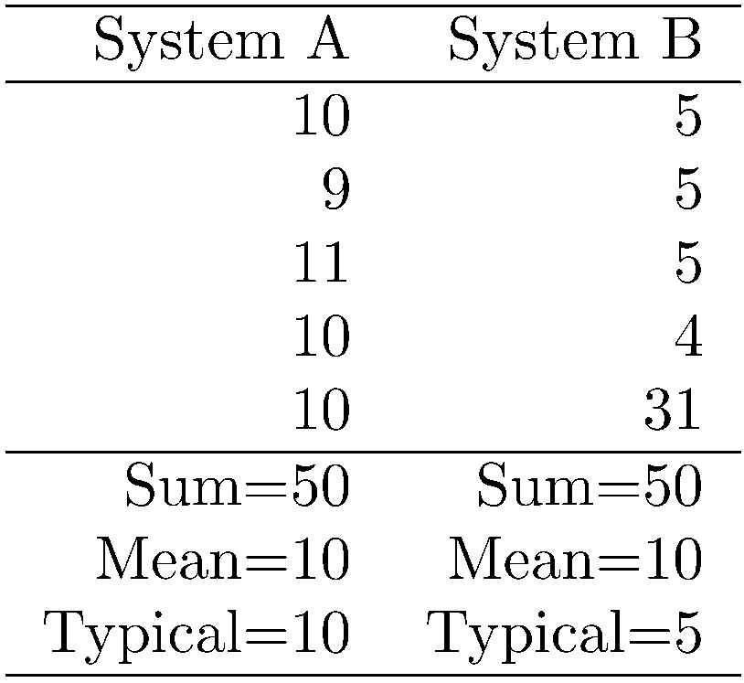
Meaning of Mean: Always Relevant?
Just the mean is not enough to use from a distribution many times:
Mean has little value if values are significantly different:
(10+1000)/2 = 505
Using mean without regard to the skewness of distribution

Slide 14
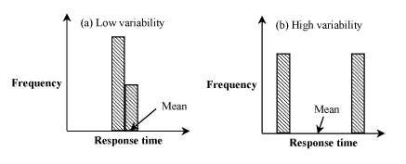
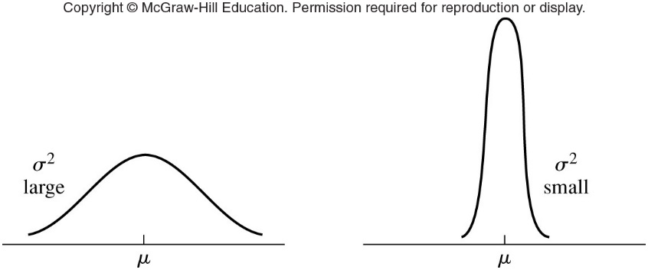
Interpretation of dispersion
Same mean but different variance/dispersion

Slide 15
Measures of Dispersion: Range
Range = Max-Min
Larger range => higher variability
In most cases, range is not very useful
Unless the variable is bounded,
  the minimum goes on decreasing with the number of observations
  the maximum goes on increasing with the number of observations,
  there is no “stable” point that gives a good indication of the actual range
Range is useful if, and only if, there is a reason to believe that the variable is bounded
Notes:
The minimum often comes out to be zero and the maximum comes out to be an “outlier” far from typical values

Slide 16
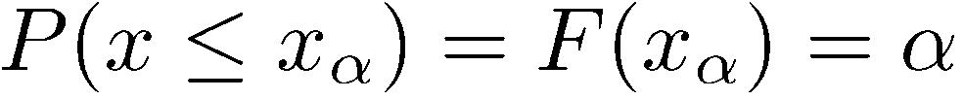
Measures Dispersion: Quantile/Percentile
Quantile: The x value at which the CDF takes a value α is called the α-quantile or 100α-percentile. It is denoted by x_{α}:
25-percentile (0.25-quantile)
1.00
0.75
F(x)
0.50
0.25
Median
0.00
x_{25-perct}
x_{median}

Slide 17
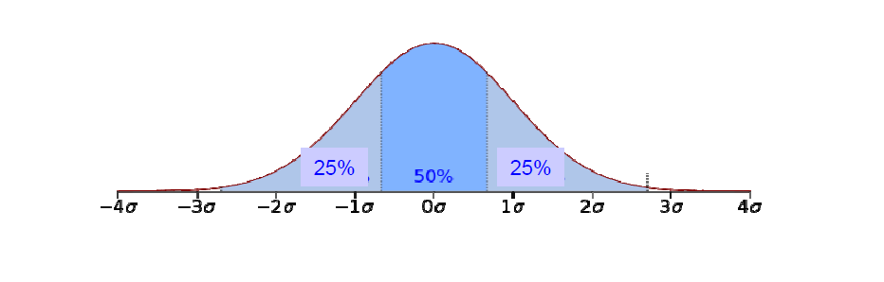
Percentiles: Other Notations
When expressed as a fraction between 0 and 1 (instead of a percent), the percentiles are also called quantiles
=> 0.9-quantile is the same as 90-percentile
Fractile = quantile
The percentiles at multiples of 10% are called deciles
  first decile is 10-percentile
  second decile is 20-percentile, and so on
Quartiles divide the data into four parts at 25%, 50%, and 75%
  25% of the observations are less than or equal to the first quartile Q₁
  50% of the observations are less than or equal to the second quartile Q₂ = Median
  75% are less than the third quartile Q₃
Q₁
Median = Q₂
Q₃
Q₁
Q₂
Q₃

Slide 18
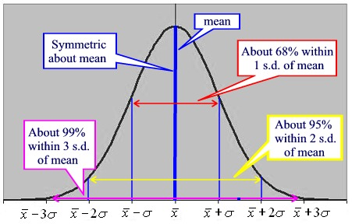
Percentiles
Specifying the 5-percentile and the 95-percentile of a variable has the same impact as specifying its minimum and maximum
It can be done for any variable, even for variables without bounds
95th-percentile
5th-percentile

Slide 19
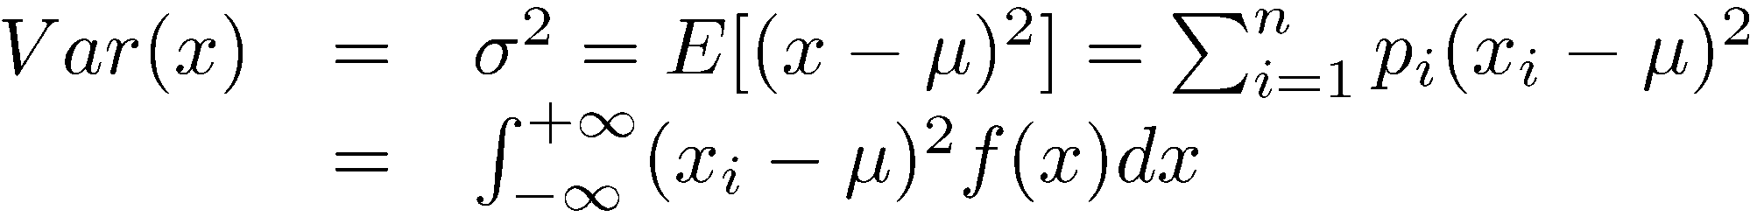
Measures of Dispersion
Variance: a measure of dispersion around the mean
  It is the expected value of the square of distance between x and its mean ()
  It measures how far the “individual” observations are from the mean of the set
    The power is to have all differences being added regardless if they are bigger or smaller to the mean

Slide 20
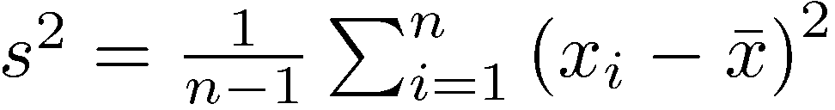
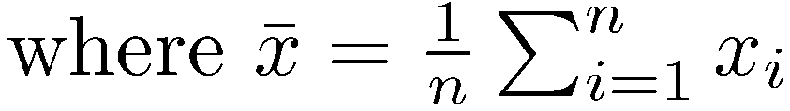
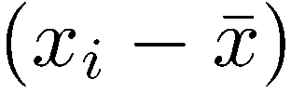
Measures of Dispersion: Variance
The divisor for s² is n-1 and not n
This is because only n-1 of the n differences
are independent
Given n-1 differences, n^{th} difference can be computed since the sum of all n differences must be zero
The number of independent terms in a sum is also called its degrees of freedom

Slide 21
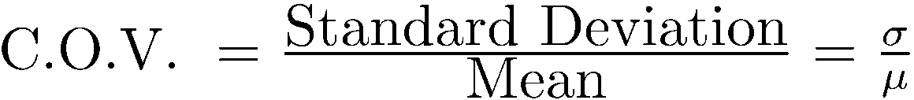
Measures of Dispersion:
Variance is expressed in units which are square of the units of the observations
=> It is preferable to use standard deviation (unitless) σ = √Var(x)
Ratio of standard deviation to the mean, or the coefficient of variation (COV), is even better because it takes the scale of measurement (unit of measurement) out of variability consideration

Slide 22
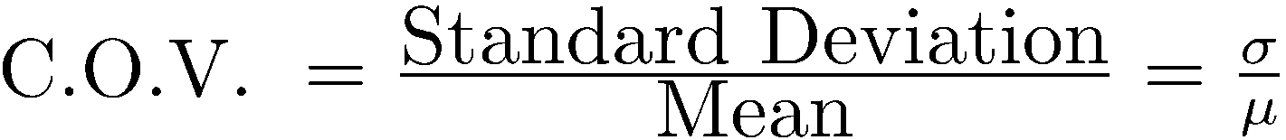
Measures of Dispersion
Standard deviation (σ): σ = √Var(x)
Coefficient of Variation: (normalized dispersion)

Slide 23
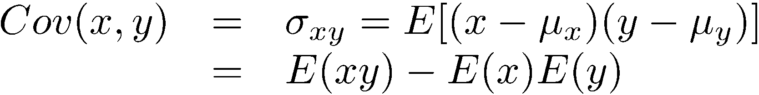
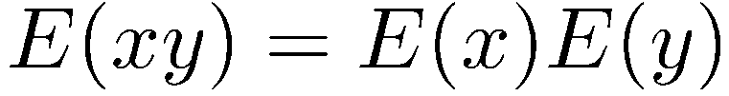
Measures of Dependence
Measures dependence between two random variables X, Y
Covariance:
For independent variables, the covariance is zero:
Although independence always implies zero covariance, the reverse is not true

Slide 24
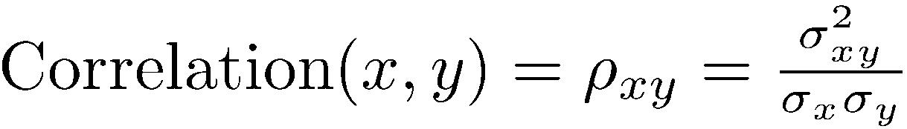
Measures of Dependence (cont)
Correlation Coefficient: normalized value of covariance
The correlation always lies between -1 and +1
  +1 implies that the two values are very related/dependent
  0 means that there is no (cor)relation between the values
  -1: negative correlation means that they are correlated but towards the opposite direction, there is a tendency to be different or to take the opposite value

Slide 25
Computation of the measures
Implementing the measures to summarize data (all samples) of a simulation

Slide 26
Sample
One example ≠ theory
One sample ≠ Definite statement
sample is an observation of the experiment and hence a value of the random variable
  A point we will obtain from the simulation
The simulation has to collect many samples, how?

Slide 27
Computation: Sample Mean
Sample Mean is obtained by taking the sum of all observations and dividing this sum by the number of observations in the sample
Algorithmic computation:
  Define : sum to accumulate samples, counter to know how many
  For each sample add the value to sum and increment the counter
  At the end, divide the sum by the counter
Example sample set: 3.1, 4.2, 2.8, 5.1, 2.8
  Mean?
Mean = 18 / 5 = 3.6

Slide 28
Computation: Sample Median
Sample Median is obtained by sorting the observations in an increasing order and taking the observation that is in the middle of the series. If the number of observations is even, the mean of the middle two values is used as a median
Algorithmic computation:
  Define vector v of all samples, counter to store number of samples
  Store every sample in the v vector and increment the counter
  At the end, order the vector and select the value in the middle position
    If even samples do the average of the two middle ones
Example sample set: 3.1, 4.2, 2.8, 5.1, 2.8
Ordered set: 2.8, 2.8, 3.1, 4.2, 5.1
Median

Slide 29
Computation: Variance
We need to first compute the mean, and then apply the difference of each sample with the mean
  Must store all samples during simulation to compute the difference
Algorithm computation:
  Define a vector v of samples, and the counter to know how many
  Store the samples during the simulation
  At the end compute first the mean and then s

Slide 30
Computation: Quartiles
The α-quantiles can be estimated by sorting the observations and taking the [(n-1)α+1]th element in the ordered set
  Here, [.] is used to denote rounding to the nearest integer
For quantities exactly half way between two integers use the lower integer

Slide 31
Computation Example: Variation Measures
In an experiment, which was repeated 32 times, the measured CPU time was found to be {3.1, 4.2, 2.8, 5.1, 2.8, 4.4, 5.6, 3.9, 3.9, 2.7, 4.1, 3.6, 3.1, 4.5, 3.8, 2.9, 3.4, 3.3, 2.8, 4.5, 4.9, 5.3, 1.9, 3.7, 3.2, 4.1, 5.1, 3.2, 3.9, 4.8, 5.9, 4.2}
The sorted set is
Median Q₂ = [ 1+(31)(0.50)] = 16th element = 3.9
First quartile Q₁ = [1+(31)(0.25)] = 9th element = 3.2
Third quartile Q₁ = [ 1+(31)(0.75)] = 24th element = 4.5
10-percentile = [ 1+(31)(0.10)] = 4th element = 2.8
90-percentile = [ 1+(31)(0.90)] = 29th element = 5.1
10-percentile
Q₁
Median = Q₂
Q₃
90-percentile
3

Slide 32
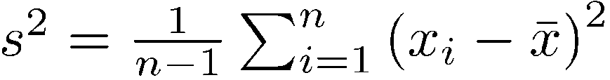


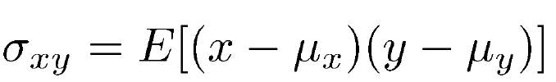
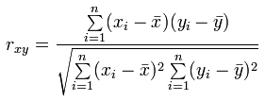

Computation: Correlation
Notes:
https://www.mathsisfun.com/data/correlation.html

Slide 33
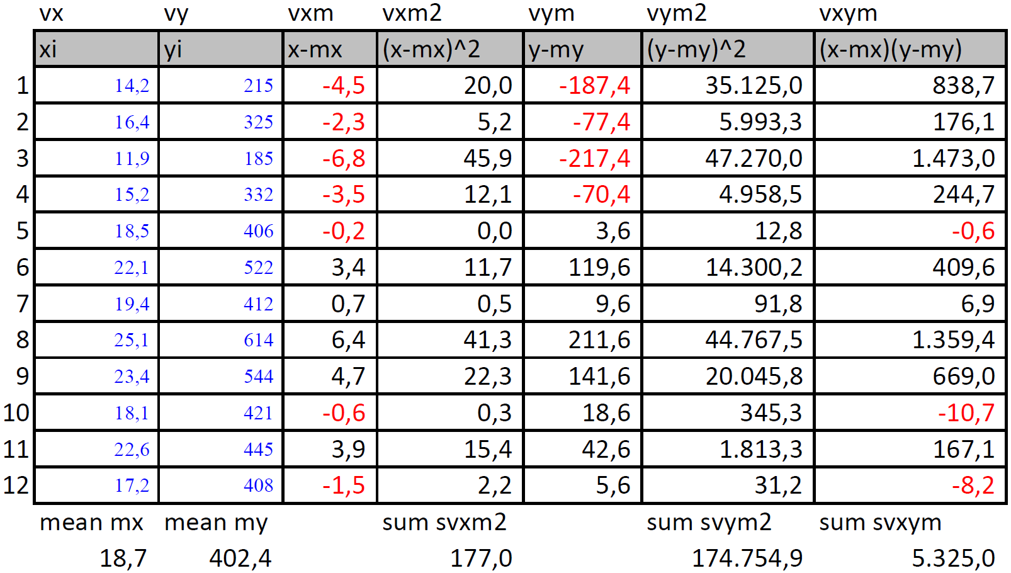
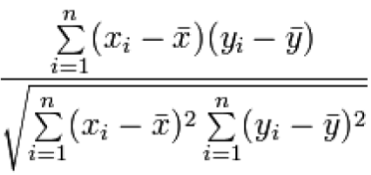
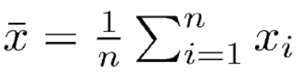

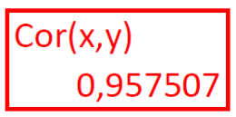
Computation: Correlation
Notes:
https://www.mathsisfun.com/data/correlation.html

Slide 34
Computation: Correlation
Given a set of observations of random variable x & y (stored in vectors vx & vy)
Compute the mean of vx (mx) and the mean of vy (my)
Each position of vx[i] and vy[i] substract mx and my to compute vxm[i] and vym[i] respectively
Compute vxy[i]=vxm[i]*vym[i]; vxm2[i]=vxm[i]²; vym2[i]=vym[i]² for every value i
Compute svxym svxm2 svym2 as the sum of all values in the vectors vxym[i], vxm2[i], vym2[i] for all i respectively
Divide svxym by square root of (svxm2 * svym2)
Notes:
https://www.mathsisfun.com/data/correlation.html

Slide 35


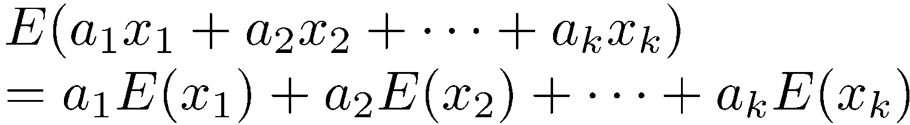
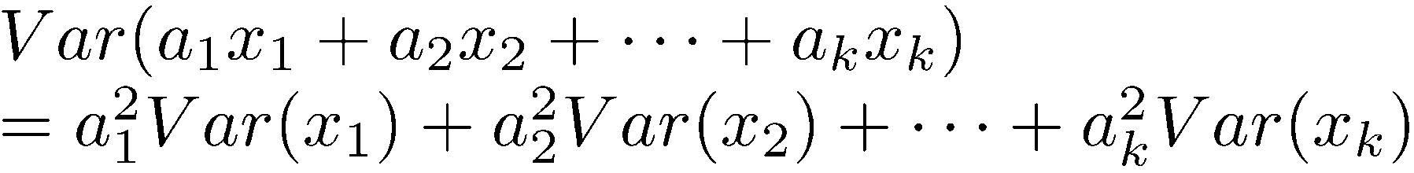
Properties: Mean & Variance of Sums
Properties are needed to combine different metrics in one
  Ex: Number of packets transmitted on average as the average across all stations of the packets transmitted per station
If
are k random variables and if
are k arbitrary constants (called weights), then:
For independent variables:

Slide 36
Distribution Function of Measured Data
The distribution collects the entire data set, not a summary

Slide 37
Distribution Function of a Measure
We want to make decisions with the results of the simulation
  The summary measures only represent particular statistical characteristics
Only the full distribution function can provide the full set of statistics to characterize a measure
The distribution is computed with the histogram
  Count observations that fall into each cell or bucket
The histogram collects all information derived from the entire set of observations without collecting them all
What to collect in the simulation to build an accurate histogram?

Slide 38
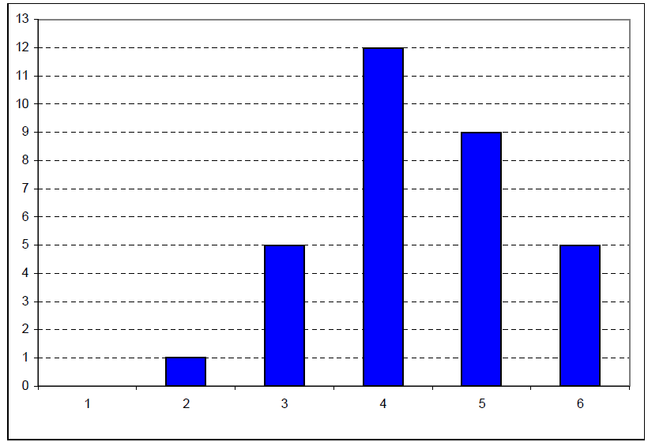
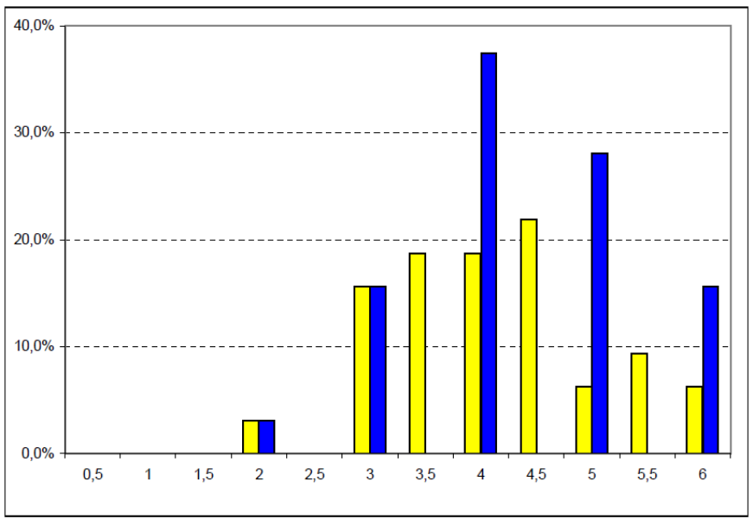

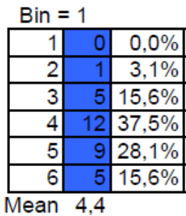
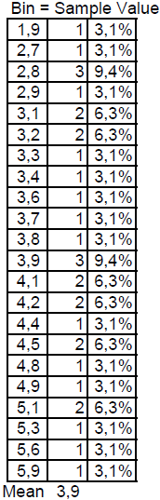
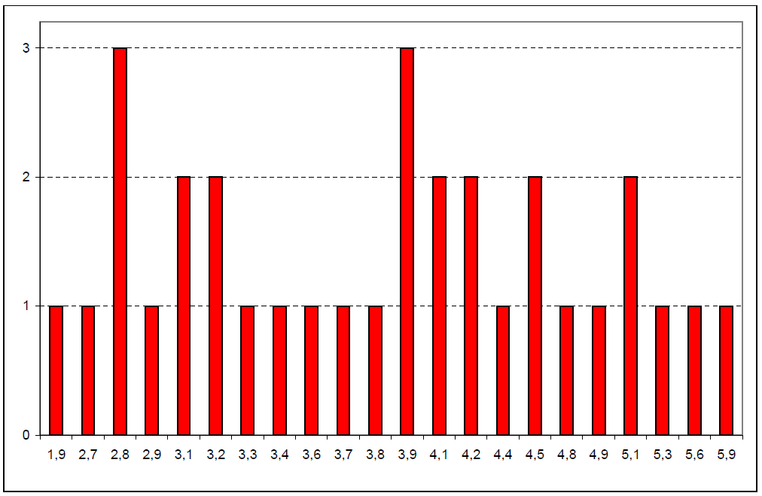
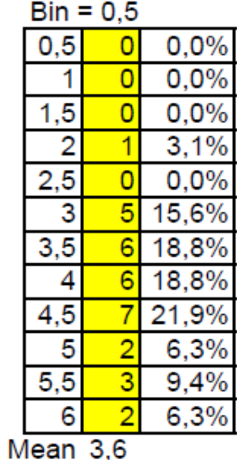
Histogram
Data Set
Histogram

Slide 39
Distribution Function of the Data
The distribution is represented by the histogram
  Count observations that fall into each cell or bucket
The key problem is determining the cell size
Small cells =>large variation in the number of observations per cell
Large cells => details of the distribution are completely lost
It is possible to reach very different conclusions about the distribution shape
One guideline: if any cell has less than five observations, the cell size should be increased or a variable cell histogram should be used

Slide 40
Identifying the Distribution of Data
It is possible to know what distribution function matches the distribution of our data set
  It is necessary to “recognize” the shape of the distribution to do the match with
  But not done in this course!
  Just one coarse approximation: gaussian approximation (next)

Slide 41
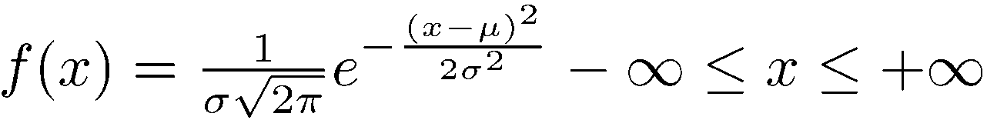
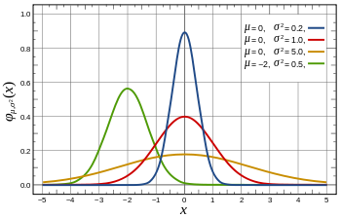
Normal (Gaussian) Distribution
A normal variate is denoted at N(μ,σ)
Standard Normal Distribution: A normal distribution with zero mean and unit variance, denoted as N(0,1)

Slide 42
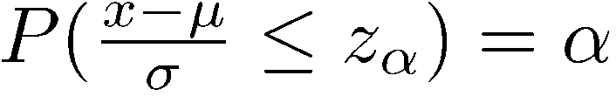
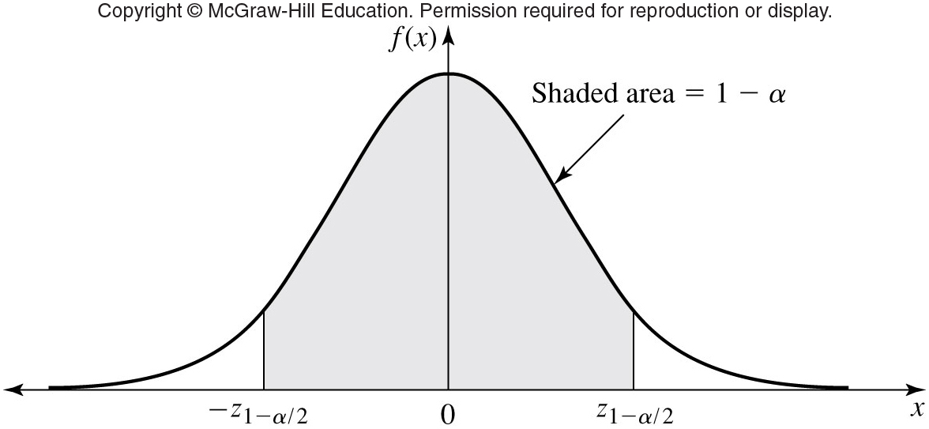
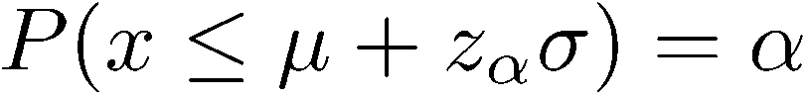
Normal Quantiles and Normalization
An α-quantile of a unit normal variate z» N(0,1) is denoted by z_{α}
If a random variable x has a N(μ, σ) distribution, then (x-μ)/σ has a N(0,1) distribution
or

Slide 43

Why Normal is so popular?
There are two main reasons for the popularity of the normal distribution:
The sum of n independent normal variates is a normal variate, this is, if,
then x=∑_{i=1}^{n} a_{i} x_{i} has a normal distribution with
mean μ=∑_{i=1}^{n} a_{i} μ_{i} and variance σ²=∑_{i=1}^{n} a_{i}²σ_{i}²
The sum of a large number of independent observations from any distribution tends to have a normal distribution. This result, which is called central limit theorem, is true for observations from all distributions
Example:
  Experimental errors caused by many factors are normal
  The grades of all students in a class

Slide 44
Central Limit Theorem: Formal Statement
Let X₁, X₂,… X_{n} be IID random variables, with finite mean μ and finite variance σ²
Let Z_{n} ^{(*)}be the random variable [X(n)- μ ] / σ²/n
Let F_{n}(z) be the distribution function of Z_{n} for a sample size of n, this is, F_{n}(z) = P(Z_{n} <= z)
then
  where Φ(z) is a N(0,1)
(*)Z_{n} is the normalized r.v. to have a 0 mean & variance 1
  X_{n} tends to a N(μ,σ ²)
  Only when n tends to ∞,this means, only for sufficiently large number of samples n
F_{n}(z) Φ(z)
^{n ∞}

Slide 45
Confidence Interval for The Mean : Definition
k samples ⇒ k Sample means
⇒ Can't get a single estimate of μ
⇒ Use bounds c₁ and c₂:
Probability{c₁ <= μ <= c₂}= 1- α
Confidence interval: [(c₁, c₂)]
Significance level: α
Confidence level: 100(1-α)
Confidence coefficient:
1-α
what distribution?
c₁
μ
c₂

Slide 46
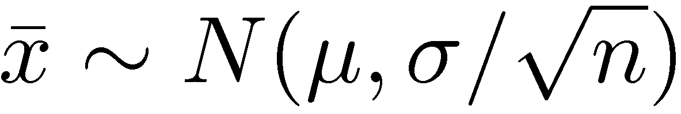
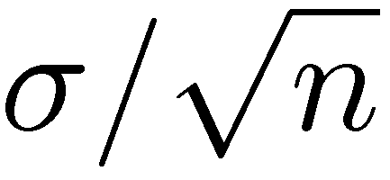
Determining Confidence Interval
We do not know the distribution of the data, but if we have enough samples we can apply the central limit theorem
Central limit theorem: Sample mean of independent and identically distributed observations:
Where μ = population mean, σ = population standard deviation
Standard Error: Standard deviation of the sample mean
=
100(1-α)% confidence interval for μ:
z_{1-α/2} = (1-α/2)-quantile of N(0,1)
Definition!
-z_{1-α/2}
0
z_{1-α/2}

Slide 47
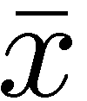
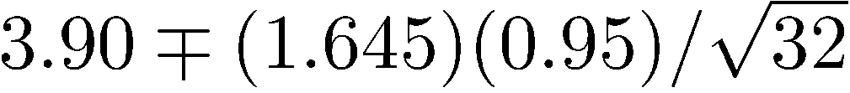
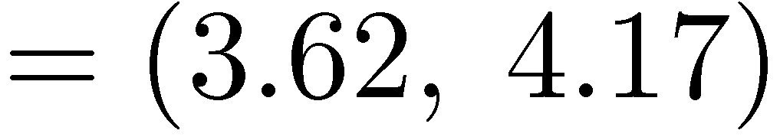
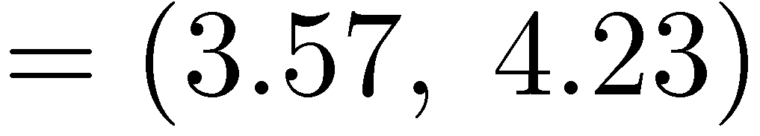
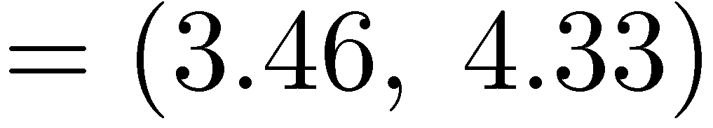
Example (Book 13.1)
= 3.90, s = 0.95 and n = 32
A 90% confidence interval for the mean
=
We can state with 90% confidence that the population mean is between 3.62 and 4.17 The chance of error in this statement is 10%

Slide 48
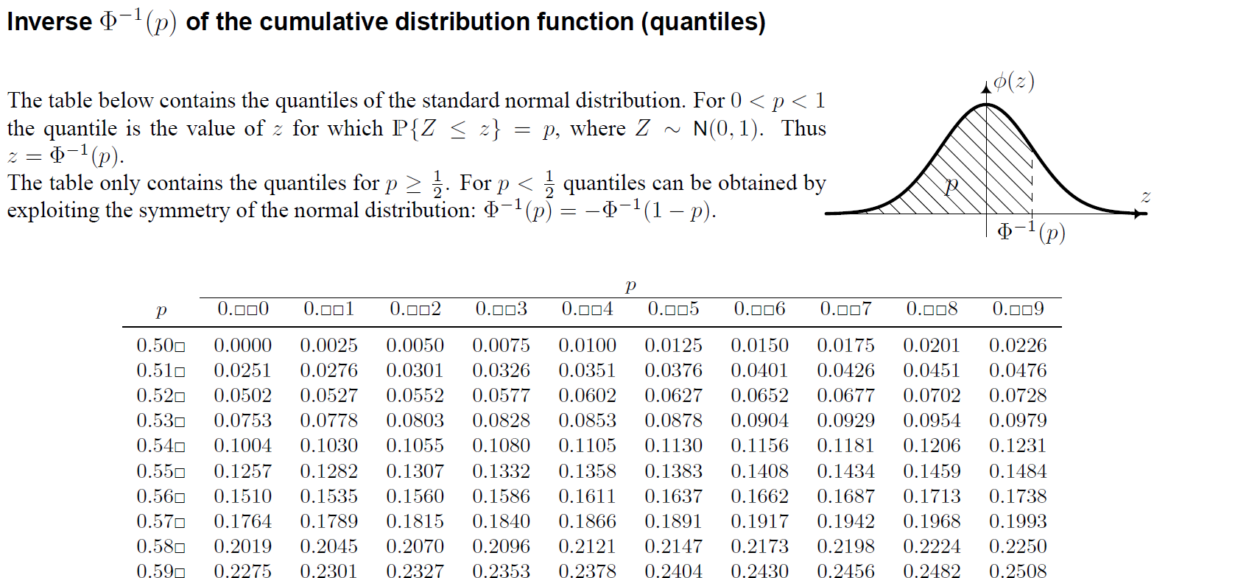
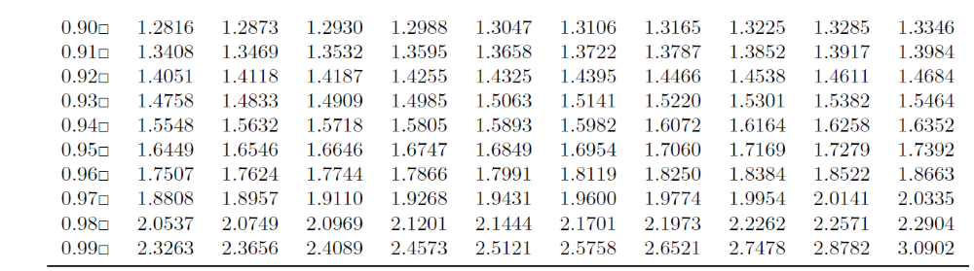
.95
.975
.995

Slide 49
Confidence Interval for Small Samples
Central limit theorem does not apply for small number of samples
  Apply t distribution instead of z distribution
  (Not done in this course)

Slide 50
More on Confident Intervals
Double-sided confidence intervals (done)
  At 1-α/2
Single-sided confidence intervals (not this course)
  At 1-α
Confidence intervals for proportions (not this course)
..

Slide 51
What have we learnt?
Basic theoretical concepts on probability and statistics
How to summarize a data set in a single number?
  What measures? How to compute them? What do they represent?
  Indices of Central Tendencies: Sample Mean, Sample Median,…
  Indices of Dispersion: Sample range, Sample variance, sample percentiles
  Indices of dependency: covariance, correlation
How to determine the distribution of a data set?
  How to compute/store it? Histogram
  What distribution is it? How to match it?
    Central limit theorem: all large enough set of observations can be approximated by a bell-shape (normal) distribution
How to measure the validity of the statistical values
  Confidence Interval

Slide 52
How will we use it?
These are the concepts/formulas to apply to the the simulation sample points to produce the simulation outcome/output
How to exactly use these formulas is worked in following theory lectures and applied in the practices handouts

